Slide 1
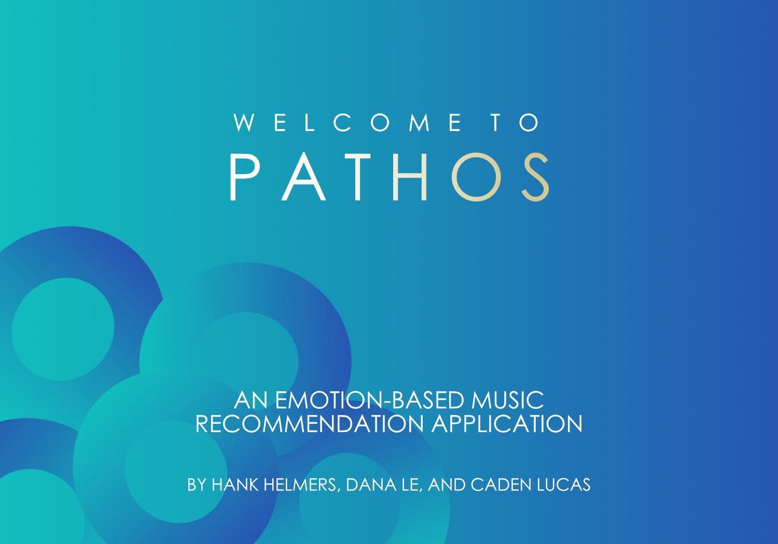
Notes:
Caden

Slide 2
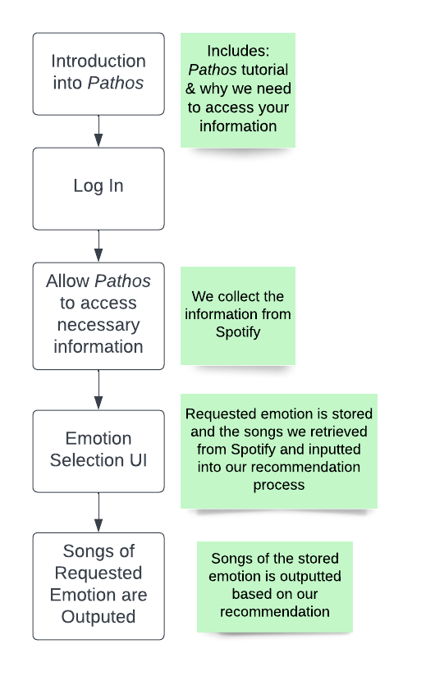
What is Pathos?
An application that recommends song choices based on the users’ requested emotion.
Works closely with Spotify to retrieve user’s song information.
Notes:
Caden & Hank

Slide 3
Application Design
MATLAB App Designer was used to create the application and UIs
Affinity Designer was used for the designs of the backgrounds and buttons
We want Pathos to be:
User-friendly
Privacy awareness for users
Straight forward
Easy to access
Notes:
Dana

Slide 4
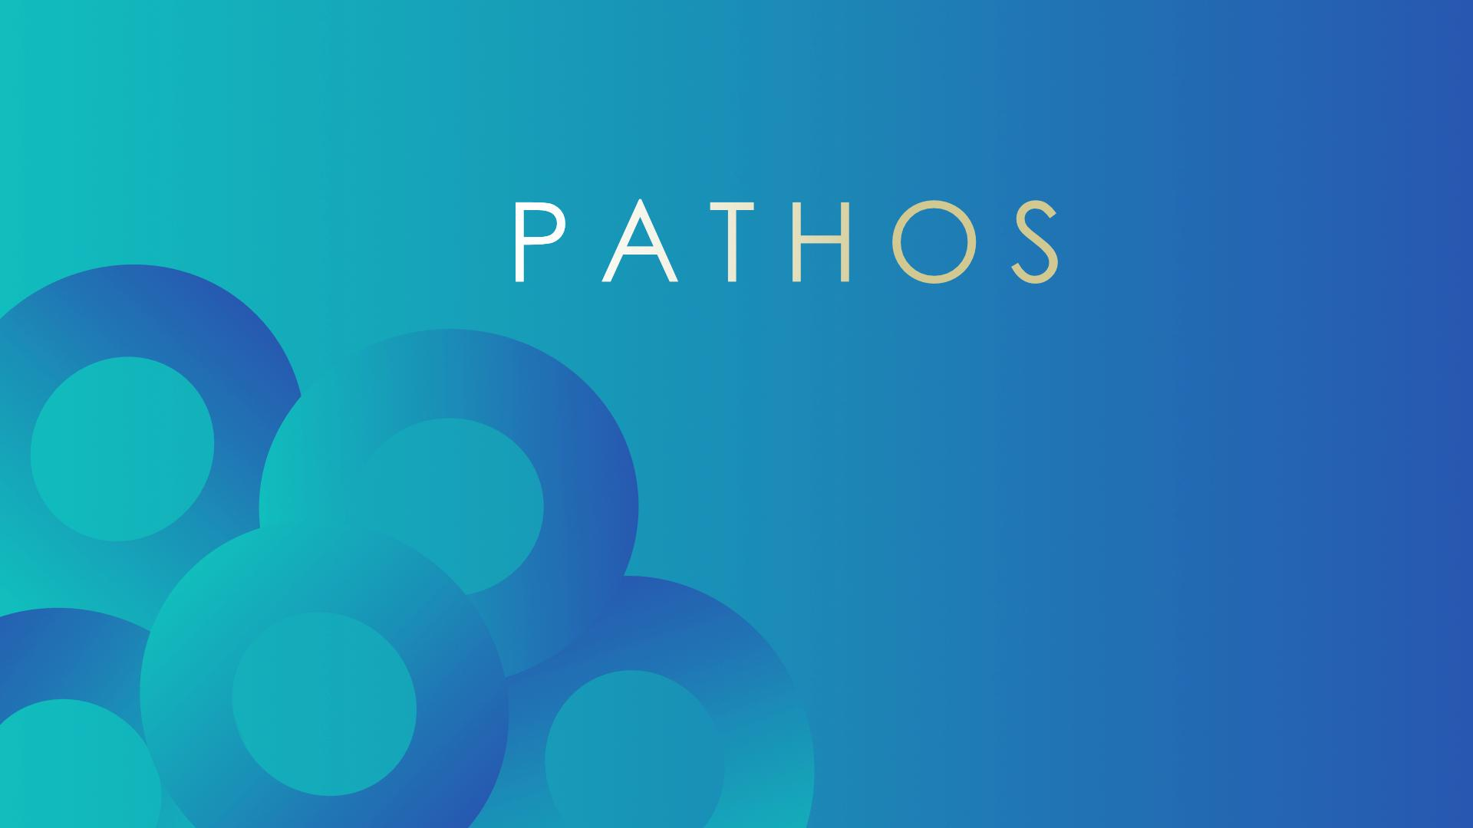
Introduction into Pathos
Notes:
Caden

Slide 5
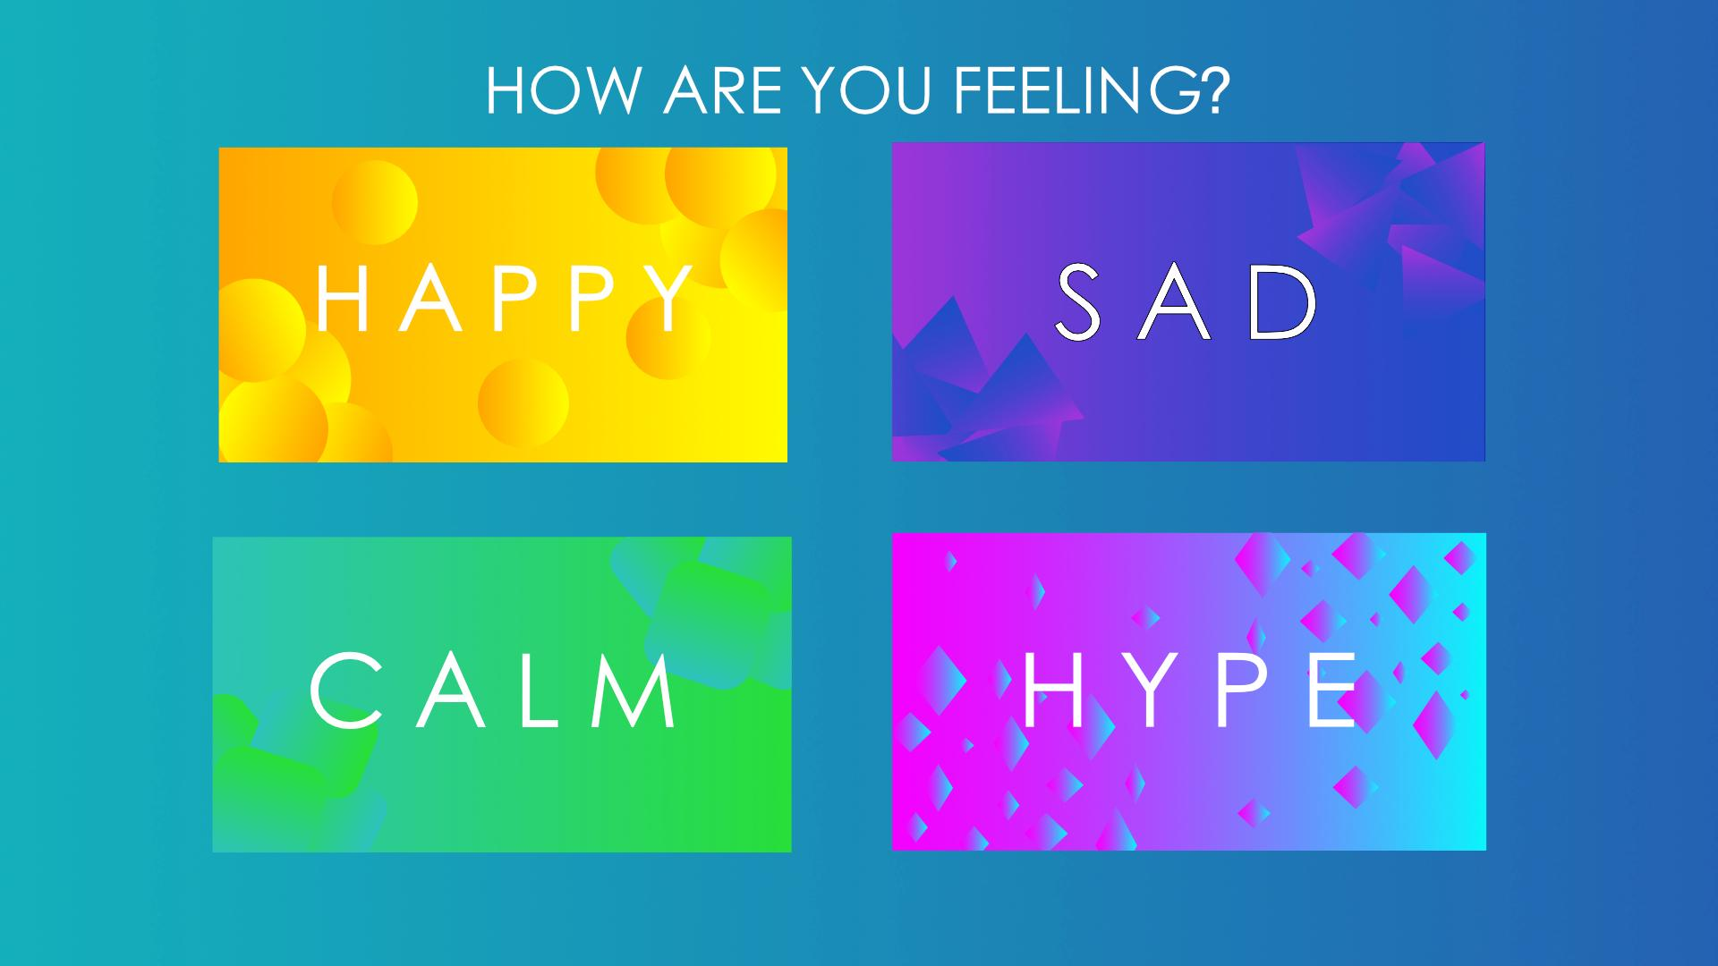
Emotion Selection
Notes:
Dana

Slide 6
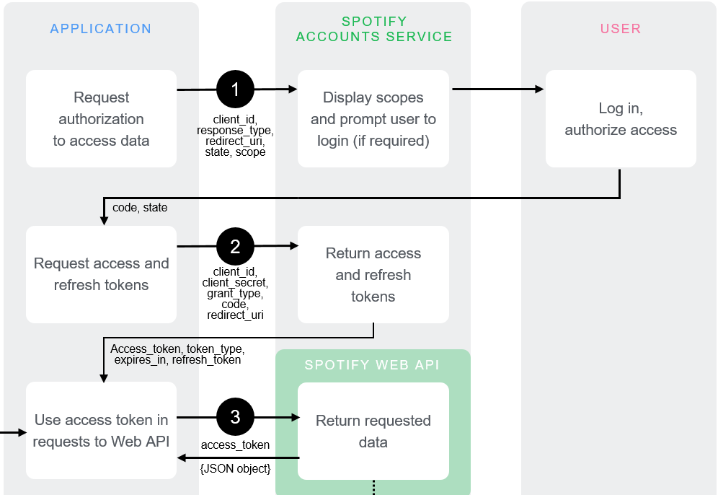
Spotify Authorization Implementation
Major Issue
Notes:
Hankinator

Slide 7
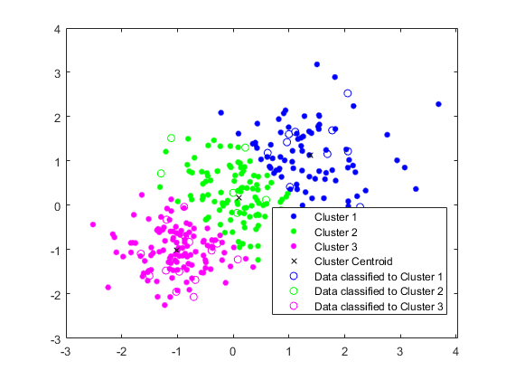
Future Developments - Bac
Designing and integrating emotion-based recommendation process.
MATLAB’s Statistics and Machine Learning Toolbox
Clustering Algorithms to sort user’s song information into different emotions based.
Such as: K-Means & Hierarchical Clustering Algorithms.
Notes:
Hank & Dana

Slide 8
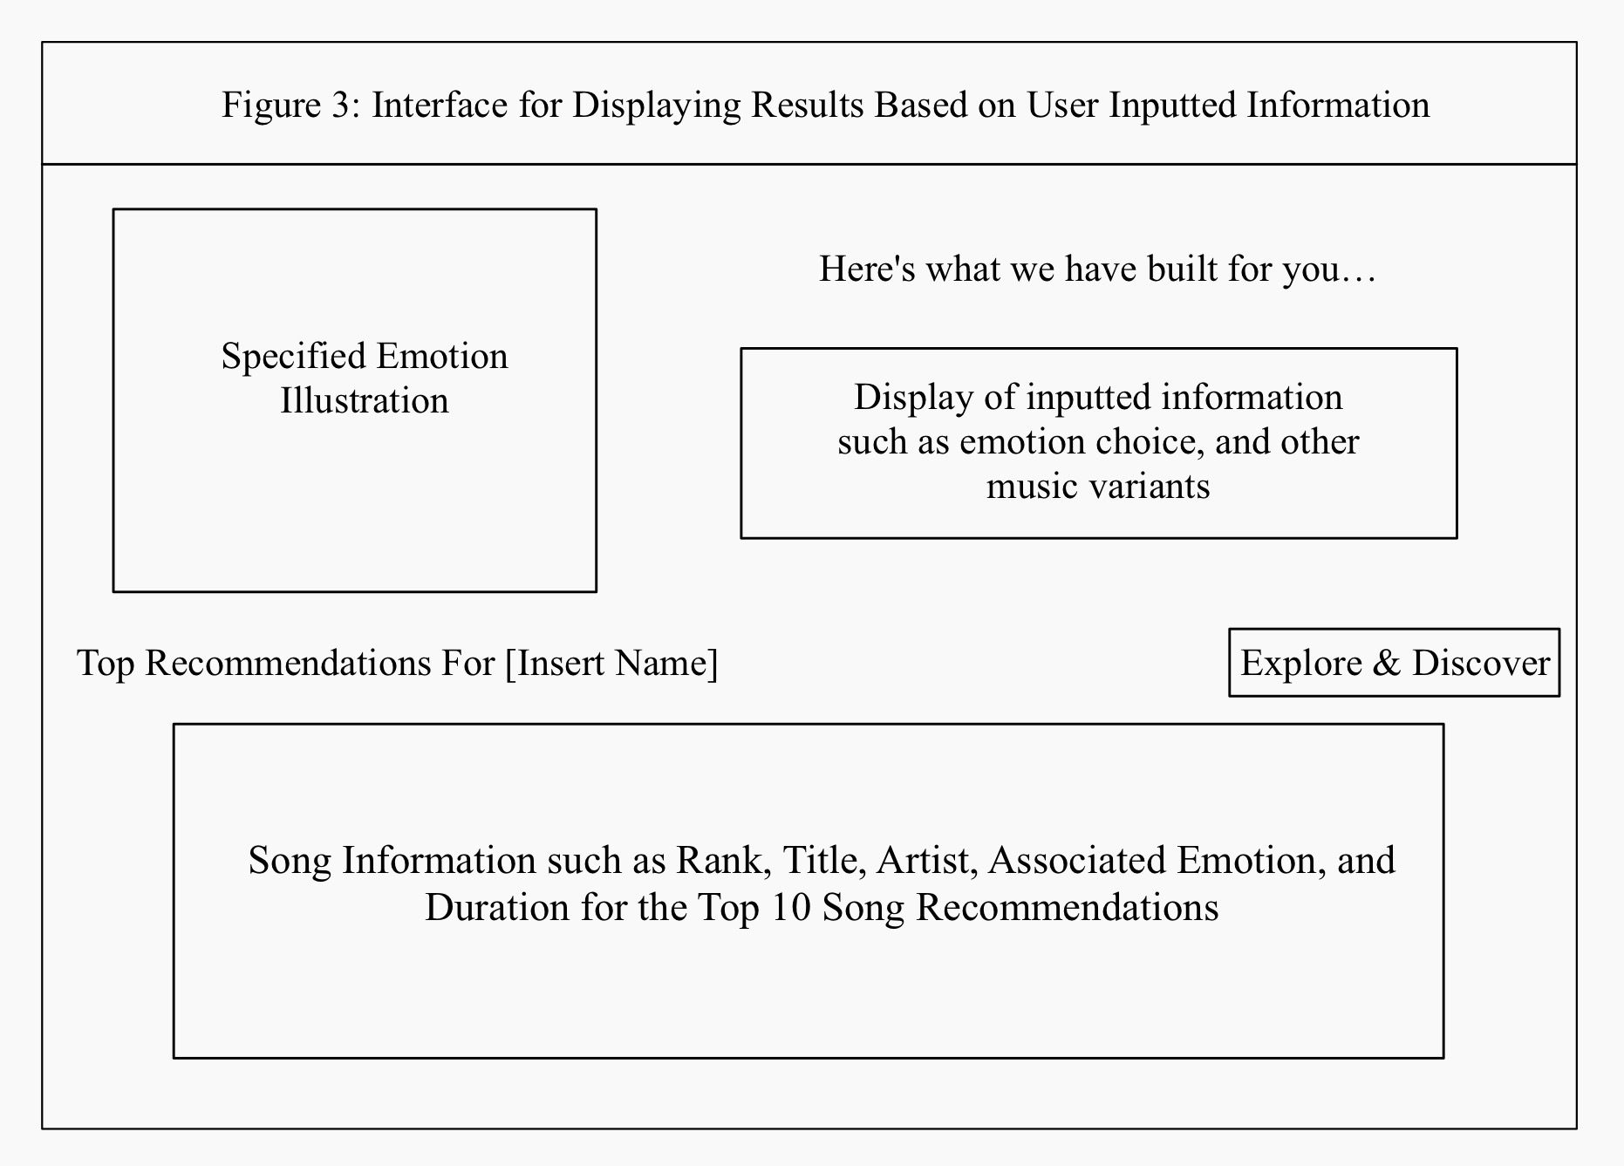
Future Developments
Designing UI to present recommendations
Show 5-10 recommendations, new set of songs
Finish the welcome/introduction UI
Step-by-step how to use, explanation of data usage, etc.
Notes:
Dana & Caden

Slide 9
Thank you for listening!
Q&A

